Slide 1

Effective resource management with AWS Config
November 2023

Slide 2
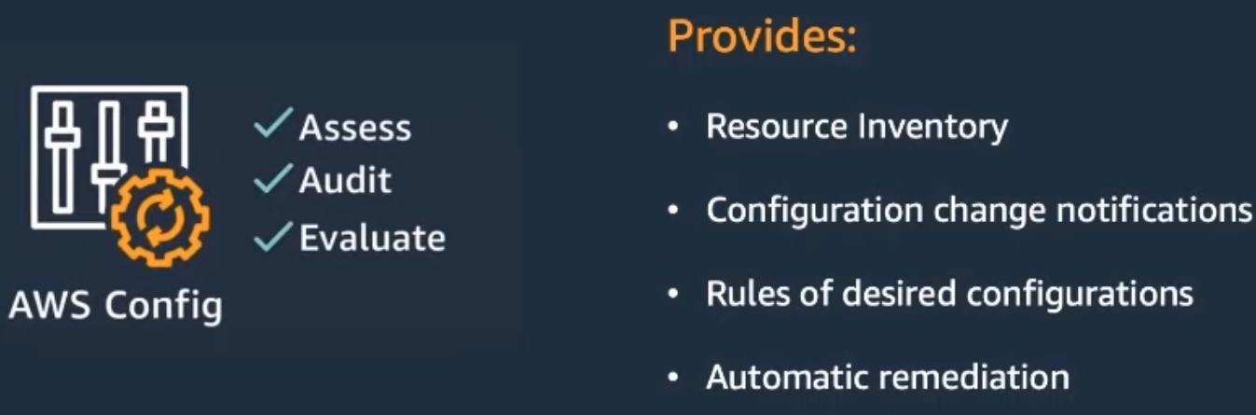
What is AWS Config?
Notes:
AWS Config is a fully managed service that provides resource inventory, configuration history, and configuration change notifications to enable security, compliance, and governance
It provides an easy way to Assess, Audit, and Evaluate the configuration of resources in your account
With AWS Config enabled, it provides a Resource Inventory of resources in your account where you can then apply rules, receive notifications, and provide remediation policies when resources deviate from a compliance state

Slide 3
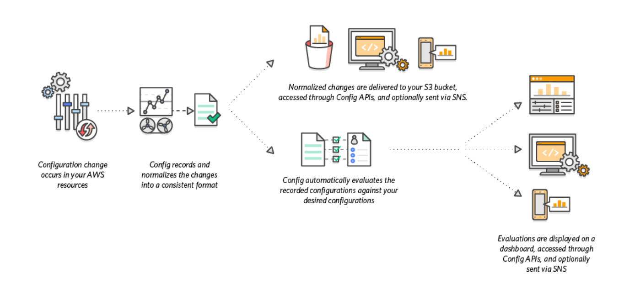
How AWS Config works
Notes:
AWS Config discovers supported resources and generates a configuration item for each resource
This is done via the Describe and List API calls
The configuration recorder generates a configuration item and maintains historical records whenever the configuration of a resource changes
Configuration items are delivered in a stream to a S3 bucket (retention is up to 7 years)
Configuration changes can also be optionally sent via SNS
When AWS Config rules are configured, the recorded configuration is evaluated against the desired configuration
The configuration status will be determined to either be COMPLIANT or NON COMPLIANT
Non Compliant resources can then remediated
Conformance Packs can be created that contain a set of rules
These can also be deployed through AWS Organizations. But this will be beyond the scope of what we will discuss today

Slide 4
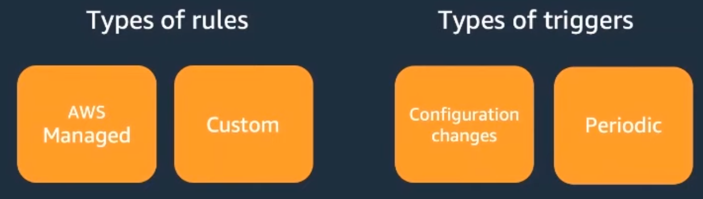
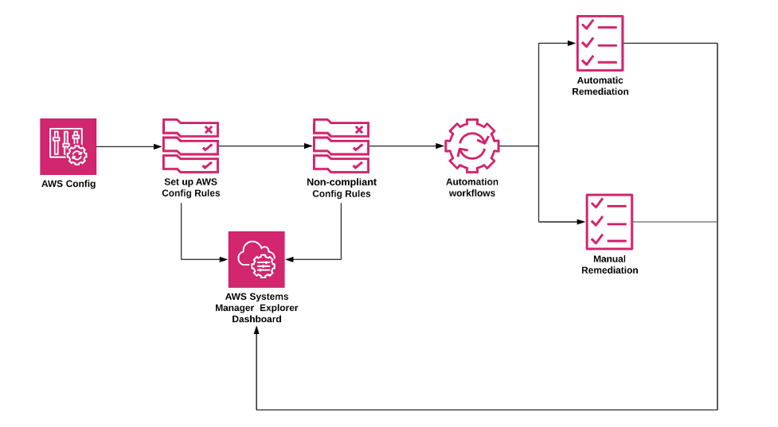
AWS Config Rules and Remediation
Notes:
Resource configuration is evaluated with AWS Config rules
These rules can either be
AWS Config Managed Rules, which are pre-defined and customizable rules created by AWS
AWS Config Custom Rules, are customer authored rules that are backed by Lambda or Guard
Evaluation of rules is done through triggers
With Configuration Changes, the rule is evaluated whenever the configuration of a resource changes
Using Periodic allows evaluation at a set frequency, for example, every 24 hours
>Remediation of noncompliant resources can be applied through Systems Manager Automation documents
Systems Manager provides a set of managed automation documents or you may create your custom Systems Manager Automation documents

Slide 5
AWS Config vs AWS CloudTrail
AWS Config
Focus on configuration of resources
WHAT has changed and HOW they change
AWS CloudTrail
Focus on events that drive configuration changes
WHO made the change, WHEN, and from WHERE
Notes:
AWS Config reports on WHAT has changed, whereas AWS CloudTrail reports on WHO made the change, WHEN, and from WHERE
AWS Config focuses on configuration of AWS resources and HOW they change, whereas AWS CloudTrail focuses on the events that DRIVE those changes

Slide 6

Problem
Lambda Hyperplane ENIs are created for each Security Group and Subnet combination
We make the most efficient use of our ENI quota by sharing the same Security Group and Subnet combination
Notes:
The problem we are trying to solve is to ensure we maintain the optimal network configuration of our Lambda functions
We know that we should share the same Security Group and Subnet combination between our Lambda functions, especially when we do not have any special inbound rules configured
This configuration can be managed with AWS Config

Slide 7










aws-config-lambda-shared-eni
Change Configuration Item
AWS Lambda
API
Rule
AWS CloudTrail
Events
AWS Config
Console
Amazon SNS
COMPLIANT
NON COMPLIANT
Notes:
> When a Lambda function changes either from the API or in the Console an event is logged in CloudTrail Events
> The configuration recorder creates a configuration item for the resource and an AWS Config Custom Rule evaluates
> The AWS Config Custom Rule, backed by AWS Lambda, evaluates whether the configuration item has the correct Security Group and Subnet combination
> It performs a PutEvaluation API call to update the configuration status
> Upon receipt of this, AWS Config updates the configuration status of the configuration item as either COMPLIANT or NON COMPLIANT
> With EventBridge notifications, a notification is also sent to an email subscription on a SNS Topic to alert on the compliancy issue

Slide 8
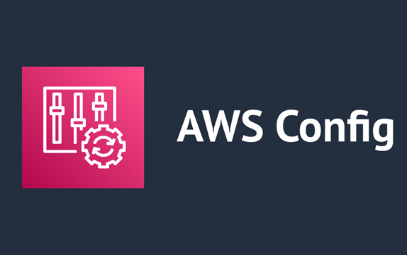
🔌Demo Time 🔨
AWS Config in action

Slide 9
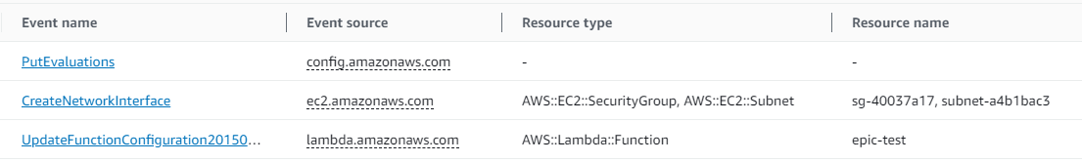
Notes:
Here we see the `epic-test` Lambda function is updated (the bottom event)
A Subnet is removed from the VPC configuration of the Lambda function, shown in the middle event
The top event shows AWS Config performed a PutEvaluations API call to update the configuration status of the configuration item

Slide 10
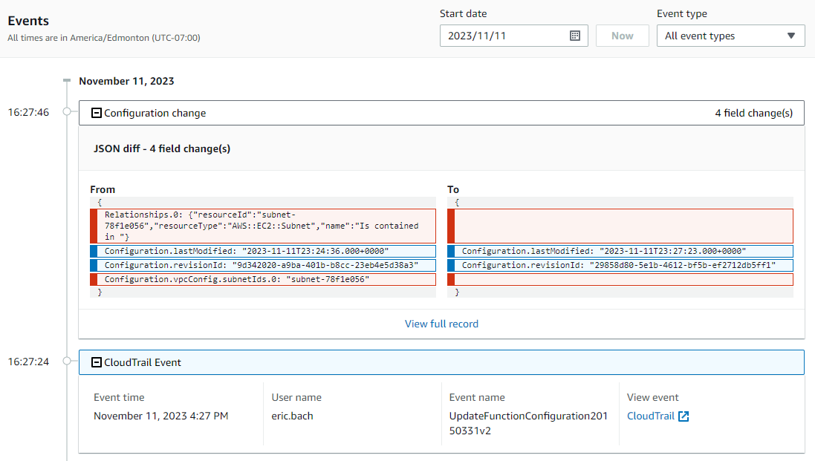
Notes:
The Resource Timeline of the configuration item shows the CloudTrail Event as well as the recorded configuration change to the network configuration

Slide 11
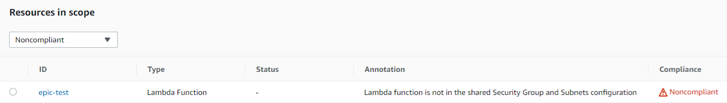
Notes:
When we check the resource, `epic-test`, in AWS Config we see the function is now marked as Noncompliant with the custom Annotation we specified in our AWS Config Custom Rule

Slide 12
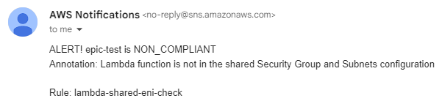
Notes:
This also sends a message to the SNS Topic with an email subscription to notify us of the mis-configuration

Slide 13
Thanks!
Feedback/Questions?
👍

